Slide 1
Basic Reading Level

Slide 2
Encourage Students to Read ANYTHING
Books
Newspaper
Magazines
Comics
Online material
Cereal boxes
ANYTHING!!!!!

Slide 3
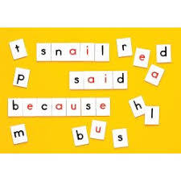
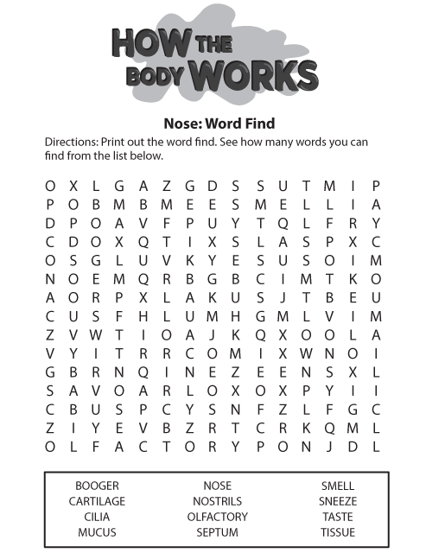
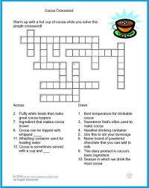
Games for Learning
Read, read, read all materials, signs, online, books, etc.
Crossword Puzzles
Word Find
Pictionary or Hangman
Letter Tiles
Memory
Puzzle pieces
Anything!

Slide 4
Five Concepts to Reading
Phonics
Understanding the sounds that correspond with the letters of the alphabet, including short and long vowels
It also involves connecting the idea that letters correspond with sounds and those sounds make words
Phonemic Awareness
Understanding the sounds that letter combinations have, including syllables, complete words, and consonant blends
Vocabulary
The understanding of the meaning of words and how to use them appropriately and adequately in sentences
Fluency
The capacity to read with the proper expression and speed, without errors
A fluent reader can read in the same manner as they speak
Comprehension
The capacity to recall characters, events, and the main concept of the passage or story once read, understanding what has been read correctly
https://files.eric.ed.gov/fulltext/ED512569.pdf

Slide 5
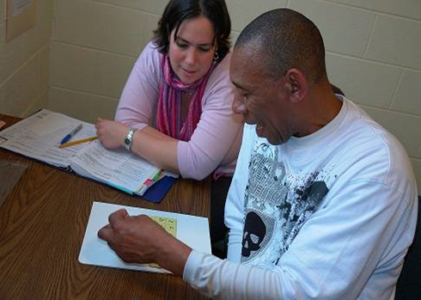
Approaches to Reading
The Phonics Method
Phonemic Awareness
Decoding
The Whole-word Approach
Fluency
Vocabulary
Comprehension
The Language Experience Method
Teach language as a whole entity
https://lincs.ed.gov/publications/html/teach_adults/teach_adults.html

Slide 6
The Phonics Method
Proceeds from part to whole
The building blocks of language
Break words down into sounds
Translate sounds into letters
Combine letters to form new words

Slide 7
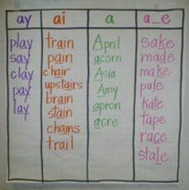
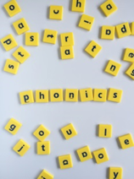
The Phonemic Method cont.
Word Lists
Word Families
Phonics Flowers
Letter Tiles – putting together words
Matching letter sounds and words
Find something that starts with …. Ends with…

Slide 8
The Whole Language Method
Student has engagement with the text
Emphasizes what the reader brings to the text
Contends that reading is driven by meaning and proceeds from whole to part
Automatic process, sometimes called sight-reading
Faster and facilitates reading comprehension

Slide 9
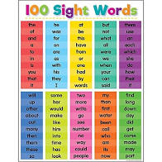
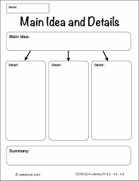
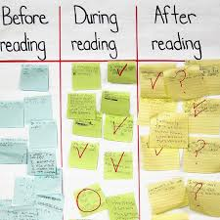
Whole Language Method cont.
Use books, magazines, poems, articles
Fluency
Duet Reading
Echo Reading
Recorded Reading
Vocabulary
Sight Words
Context Clues
Signal Words
Comprehension
Graphic (visual) organizers
Critical thinking questions

Slide 10
The Language Experience Method
Integrates speaking and listening, reading and writing through the development of a written text based on first hand experiences
Emphasize differences between spoken language and written language
Use familiar and expanded vocabulary, modelling ways in which their thoughts and words can be written down and later read
Capitalise on students’ interest and experiences
Prompt the students to reflect on the experiences
Ask questions to elicit details about the experience through more explicit language
Help students to rehearse the ideas they will be writing about

Slide 11
Language Experience Method cont.
Everyday happenings
Common school experiences
Classroom event or hands-on activity
Excursions
Students' personal experiences or ideas

Slide 12
Lesson Ideas for Reading and Writing
http://www.eastsideliteracy.org/tutorsupport/RW/RWIdeas.htm
https://www.ncsall.net/fileadmin/resources/teach/uwriaa.pdf
https://floridaliteracy.org/

