Slide 2
Our Students

Slide 3
Our Students Demographic Data
2,453 Individual Students Served
Time Period:
7/1/2014 – 6/30/2019

Slide 4
Our Students Where Do LANEFL Students Come From?
Florida State College at Jacksonville Walk-Ins Internet Searches Promotional Fliers Word of Mouth (family, friends, current students) Jacksonville Public Library’s Center for Adult Learning Clara White Mission Department of Children and Families (DCF) IM Sulzbacher Center | Mental Health Resource Center Quality of Life Center Career Source Family Support Services (FSS) Jacksonville Re-Entry Center (JREC) Operation New Hope Other Community-Based Organizations in Jacksonville Pace Center for Girls The Waves at Jacksonville Beach

Slide 5
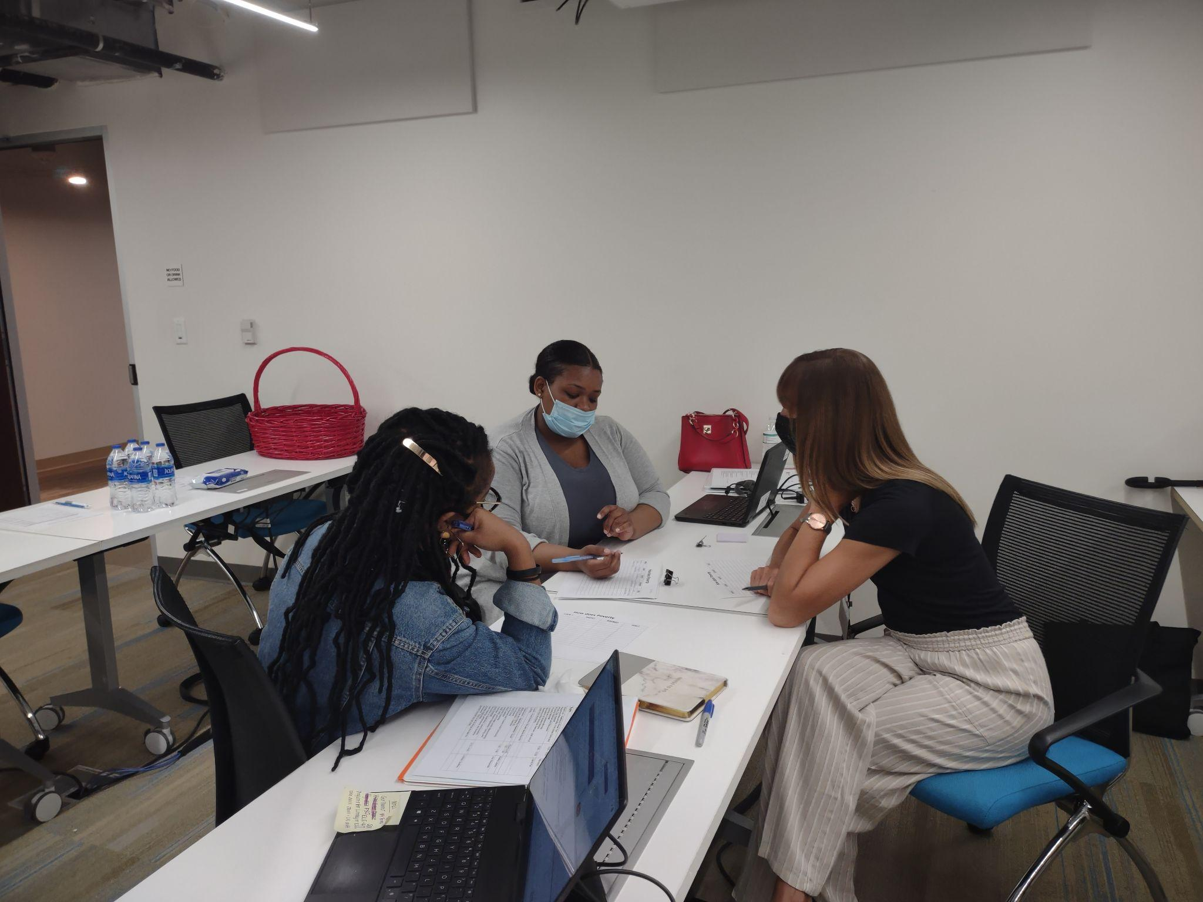
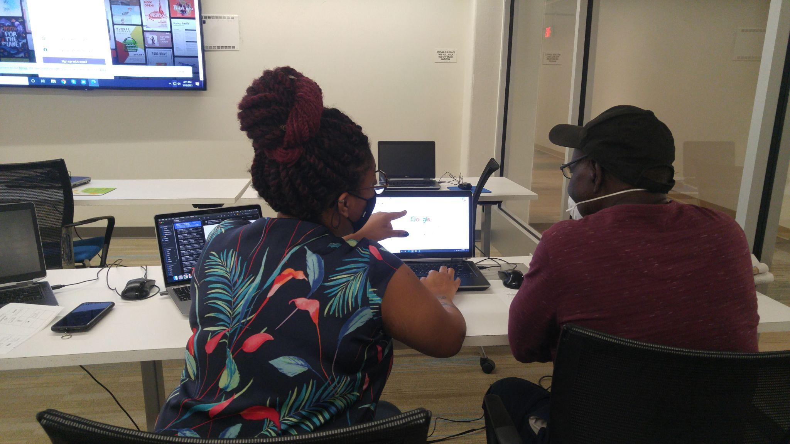
Our Students Student Intake Process
Student Intake Appointment
(registration)
Bring an Assessment/Take an Assessment
(tabe/casas placement test)
Enroll in classes and/or tutoring

Slide 6
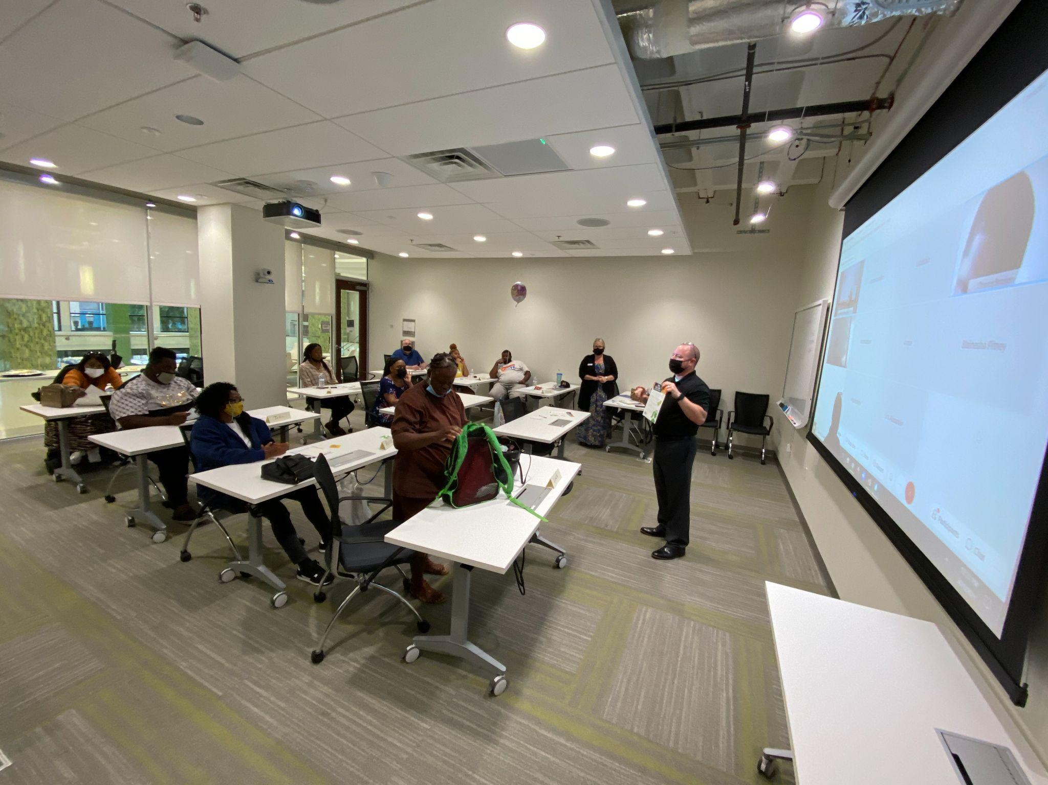
Our Students Student Options
Computer Lab/Study Hall
Small Group Classes
One-on-One Tutoring
Health and Financial Literacy Workshops

Slide 7
Our Students Student Options
Reading, Math, Social Studies, Science or other student-indicated goal
Individualized and flexible
Tutoring
One-on-one
Any public location or online

Slide 8
Tutoring
with the Literacy Alliance

Slide 9
Tutoring with LANEFL: Getting Matched
After our meeting today…
You will get an email from the Volunteer Coordinator with this PowerPoint
Go over the Resources section at the end of the PowerPoint
Included on the email will be LANEFL’s Student Success Coordinator (SSC)
The Student Success Coordinator will review your preferences/availability
The SSC will reach out when a potential student that matches your preferences is identified
If you agree with the match, you’ll get your student’s contact details to set up your first meeting
SSC will recommend additional ProLiteracy modules for you based on your student’s level and needs
SSC will provide you with your student’s most recent test scores and goals for tutoring
SSC will suggest learning materials for your tutoring sessions from LANEFL’s office.
You can pick these up at the office any time Monday-Friday 9-4!

Slide 10
Tutoring with LANEFL One on One Tutoring – First Contact
First contact: Call the student.
Set day, time, and place to meet in person or virtual meeting logistics
Exchange/confirm phone numbers and email addresses
Inform LANEFL Student Success Coordinator of your projected start date
Pick up curriculum and workbooks from LANEFL

Slide 11
Tutoring with LANEFL One on One Tutoring – Location of Tutoring
We require that all Tutor Pairs meet in public locations. Some acceptable examples include:
Libraries (study rooms may be reserved for free at branch locations)
DuPont Center during the day Monday through Friday
Coffee shop
Park
Church
Apartment Clubhouse
Online using webex, zoom, or another online meeting tool
Inappropriate places include:
Any private residence or home
Bars

Slide 12
Tutoring with LANEFL One on One Tutoring – First Meeting
Introduce each other
Discuss rules, responsibilities, and expectations
Late/cancellation/no-show policy
Homework
Participation
Sign agreement from Tutor Handbook (optional)
Plan, schedule, and confirm site
Discuss goals for tutoring including educational and career goals
Get to know each other
Learning Skills Inventory
Likes and dislikes, hobbies, etc.
Wrap up

Slide 13
Tutoring with LANEFL One on One Tutoring – Long Term Goals
Common student indicated goals include:
Improving on reading level to enroll in a GED or Vocational program
Earning a high school diploma by passing the GED exam
Getting a job or a promotion
Getting a degree

Slide 14
Tutoring with LANEFL One on One Tutoring – Short Term Goals
Focus on Short Term Goals! They may include:
Mastering letter sounds; writing legibly
Filling out applications and forms independently
Reading in church; participating in faith-based activities
Passing the drivers license exam
Reading mail, contracts, cards from friends
Following recipes or written directions
Reading to a child; helping children with homework
Using the Internet and sending e-mails
Getting a library card

Slide 15
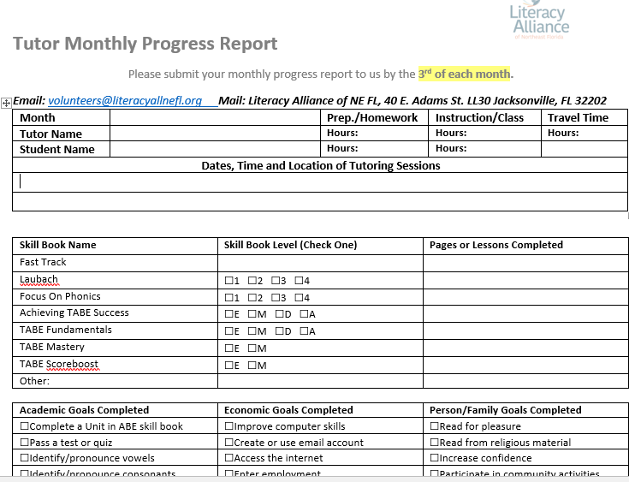
Tutoring with LANEFL One on One Tutoring – Monthly Progress Report
Monthly Progress Report
Due by the 3rd of each month
By email to volunteers@literacyallnefl.org
In person to the Literacy Alliance office
Online version via a link in my monthly email
Progress Reports allow you and your student to see what was achieved in a month. They keep motivation high! Adds instructional hours to your student’s record.
Students need instructional hours in order to test out/take tests!
Our funders and granters want to know about instructional hours and students’ progress towards goals!

Slide 16
Tutoring with LANEFL: One on One Tutoring – Report Progress on Goals
Report your goals! Our grants specifically focus on:
Academic Goals
Gain an Educational Functioning Level
Complete skills workbooks
Personal/Family Goals
Pass the driver’s license exam
Get a library card
Read for pleasure
Reading to your children/grandchildren
Economic Goals
Job applications completed
Create a Resume
Creating a budget

Slide 17
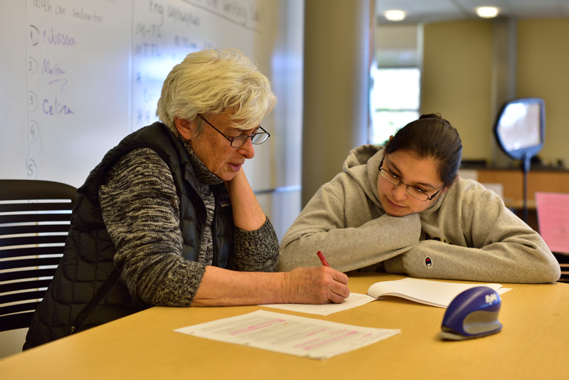
Tutoring with LANEFL Potential Issues
A student doesn’t call to cancel
A student doesn’t complete homework
A student is always late to meetings
A student isn’t making progress OR is moving too quickly through their current skill book
A student feels insecure about using new skills
You do not feel adequately prepared to start tutoring at the end of this workshop
You need to cancel a session
Please call us to help resolve any issues! Or, if you need suggestions.

Slide 18
Tutoring with LANEF Setting Boundaries
Tutor only in public places
Avoid conversations about religion and politics
Avoid giving advice (about relationships, finances, medical decisions, etc.)
DO NOT: loan or borrow money; give or accept gifts; use the relationships to buy or sell merchandise; hire student for work; transport students in your vehicle

Slide 19
Tutoring with LANEFL: Student Advocate
The Literacy Alliance has a student advocate on staff who can help connect students to resources that are outside the scope of tutoring. If you hear your student mention a struggle or need, contact the Student Success Coordinator and they will get the student connected!
For instance, barriers involving:
Safety
Food
Shelter
Medical care
Child care

Slide 20
The Adult Learner

Slide 21
The Adult Learner Characteristics of Adult Learners
Independent
Flexibility
Able to Make Own Decisions
Self-Motivated
ARE
Employment
Practical Lessons
NEED
Goal
Related
Tasks
Responsible
Adaptable
Anxiety
Education
BRING
Creative
Be Actively Involved in Learning
Apprehension
Life
Want to Learn

Slide 22
Self-concept. Adult learners have a self-concept. This means that they are autonomous, independent, and self-directed.
Learning from Experience. Experience as a rich resource of learning. Adults learn from their previous experiences. Thus, it is a good repository for learning.
Readiness to Learn. Adults tend to gravitate towards learning matters that matter to them. Their readiness to learn things is highly correlated with their relative uses.
Immediate Applications. The orientation of adult learning is for immediate applications rather than future uses. The learning orientation of adults tends to slant towards being task-oriented, life-focused, and problem-centric.
Internally Motivated. Adults are more motivated by internal personal factors rather than external coaxes and pressures.
Need to Know. Adult learners have the need to know the value of what they are learning and know the why’s behind the need to learn them.

Slide 24
The Adult Learner Learning Barriers
Why are so many adults poor readers?
The biggest cause of illiteracy among native English speakers is an environment of poverty, an environment that often includes poorly educated parents, poor schools, lack of enrichment activities, and low expectations.
A second cause is personal childhood barriers, which might mean physical or mental impairments, learning disabilities, abuse, or dysfunctional families.”
-LitStart: Strategies for Adult Literacy and ESL TUTORS

Slide 25
The Adult Learner Learning Disabilities
A “Learning Disability” is not related to IQ. It is a broad term used to identify several perceptual disorders.
It is estimated that 15 – 20% of the population as a whole has a learning disability and that 50 – 80% of all students in adult literacy programs may have learning disabilities. *
Our records showed about 51% of our students either disclosed a learning issue or showed evidence of one from a screening questionnaire.
Source: National Institute for Literacy, 23rd Annual Report to Congress, 2001

Slide 26
Working
with Students

Slide 27
Working with Students Best Practices
Actively involve student
Relate materials to student’s experiences
Use real experiences, real-life scenarios from their life
Vary teaching style and activities
Create a positive learning environment
Encourage Study and Organizational Skills
Lesson Planning
Use student’s goals as a driving force for lesson planning

Slide 28
Working with Students Varying Teaching Style and Activities
Be creative
Use different color markers or highlighters to make letters or words
stand out
Include multisensory activities (auditory, visual, kinesthetic)
Present concepts using different techniques (an example, a picture, a
story, or an action)
Change technique when it’s not working
Assess and cater to student’s strengths/learning style
*Learning Styles Inventory handout

Slide 29
Working with Students Lesson Plans
Lesson Planning
Lesson Topic:
Identifying Main Idea/Topic Sentences
Goals and Objectives:
Students will be able to verbally give a definition of main idea/topic sentence
Students will be able to identify main idea/topic sentences of paragraphs
Students will be able to write their own main idea/topic sentences
Materials:
TABE Skill Workbooks Level E
Grade Equivalency 2.0-3.9
*See Lesson Plan Template in Training folder

Slide 30
Working with Students PPP Instructional Method
Presentation, Practice, Production or I DO, WE DO, YOU DO
Breaks learning into smaller steps
Easy for learners to follow and remain focused.
Teacher is the role model for learning using think aloud
Allows for regular feedback, correction, and assessment
Provides targeted practice and helps to increase long term memory
Builds confidence

Slide 31
Working with Students Language Experience Approach
Integrates speaking and listening, reading and writing through the development of a written text based on first hand experiences
Student shares an experience
Creating the Text
Verbally recreate the shared experience
Teacher transcribes the student’s words in an organized way to create the text
Read & Revise
Read story aloud and discusses it
Teacher asks if the students want to make any corrections or additions to the story
Mark the changes suggested, makes further suggestions
Read and Reread
Tutor reads, read together, student reads

Slide 32
Resources
to further your learning
as a volunteer tutor

Slide 33
The Adult Learner
Living in the Shadows
Watch the video by clicking the picture
What obstacles have these adults encountered?
What is the cost of illiteracy?
How will this story guide your approach to students?

Slide 34
Tutoring with LANEF Setting Mutual Expectations Using
Intentional and Explicit Language
Having a conversation about working together: I think it would be helpful for us to talk about how we’re going to work together on this material. Let’s communicate with each other and an agreed-upon timeline.
Providing the student with a choice: Would you like to meet for our tutoring session online or in-person? At Literacy Alliance or at library? Would you rather work on your Reasoning Through Language Arts goal or Math goal?
Establishing clear expectations: I am available by email. If you need to cancel your tutoring session, please let me know 24 hours in advance.
Explaining rationale for self-disclosure: It might be helpful for me to share my experience as an adult learner to help you think about your situation, or at least let you know alone in experiencing challenges of balancing, life, work and school.
Including the students’ voice and needs: How would you like to approach our meeting this afternoon? What would you like to focus on, given your academic goals?
-from Interpersonal Boundaries in Teaching and Learning by Harriet L. Schwartz (2012)

Slide 35
Tutoring with LANEF Setting Boundaries
How to Have Boundaries in Adult Education:
https://www.youtube.com/watch?v=Xuw5_TBvEUA

Slide 36
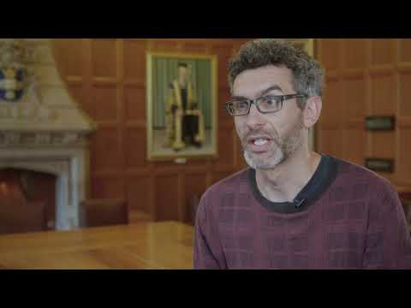
Tutoring with LANEF Self Care Tips for Tutors

Slide 37
Working with Students Video Tutorial
Language Experience Approach
Video

Slide 38
Working with Students PPP Method of Instruction
PPP Method: PRESENTATION (“I do”)
Hook: Introduces topic/skill
Discussion question
Picture
Presentation: Demonstrates topic/skill
Teacher-Led
Use 3 methods (picture, example, action)
CCQ: Concept Checking Question
Targeted Yes or No question that assesses students’ basic understanding

Slide 39
Working with Students PPP Method of Instruction
PPP Method: PRACTICE (“We do”)
Guided practice
Teacher - Student
Provide correction
Activities
Find the Mistake
Worksheet

Slide 40
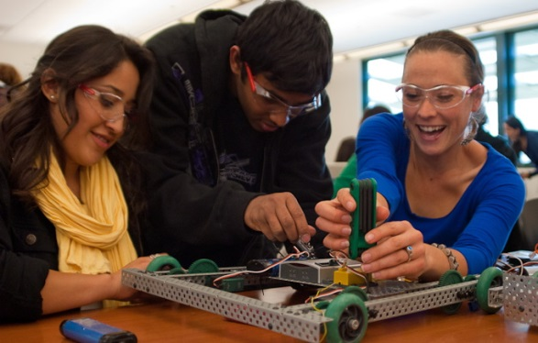
Working with Students PPP Method of Instruction
PPP Method: PRODUCTION (“You do”)
Student demonstrates skill successfully
Student-Student
Observe and monitor
Activities
Real life context/scenario
Independent activity

Slide 41
Working with Students PPP Method Tutorial Videos
“I do”
https://www.youtube.com/watch?v=HJJL7hQDM8I
“We do”
https://www.youtube.com/watch?v=yAtw9cTWPeQ
“You do”
https://www.youtube.com/watch?v=L44FNswJ_cc

Slide 42
Tutoring with LANEF: Events
2022 Celebration of Success
Each year, we host a Celebration of Success dinner to honor our student achievements and volunteers.
Here’s our video slide show from 2022!

